Slide 1

Library Database System
Danielle Senechal (Project Leader)
Margaret Zhang
Eve Jimenez
Sean Mosley

Slide 2
Introduction
The project presented is a Library database program.
When the program runs, a website is created, that hosts a library webpage, when browsing around, the user is given options between
creating an account
Search for media
Rent and return any library property.
The Program
Keeps track of books, CDs, movies, and other content available for rent, and which ones are out.
Keep tracks of the content users are taking out when they rent products.
Creating and maintaining the accounts tied to the library.

Slide 3
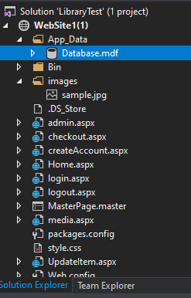
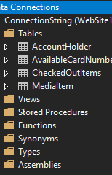
Tools
For backend and functions:
asp.Net
For Styling the web page:
HTML
CSS
For handling media database:
SQL
4 Tables

Slide 4
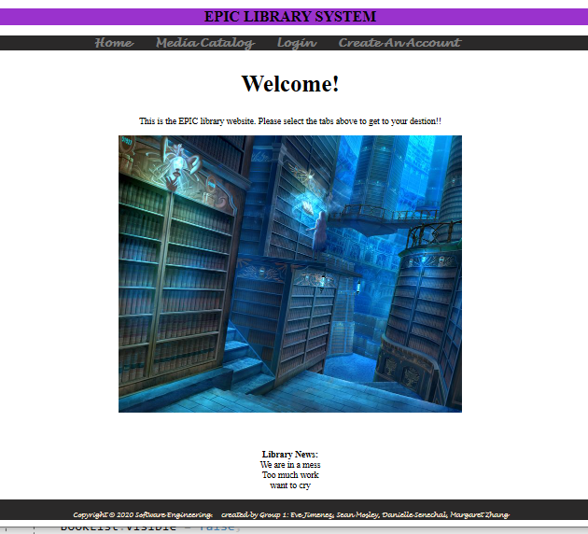
Demonstration: Home Page
Users first impression of the site
Navigation bar is at the top:
Login
Create Account
Media Catalog/Search
Home / Refresh
Library News added at the bottom to promote engagement
Copyright gives credit to creators

Slide 5
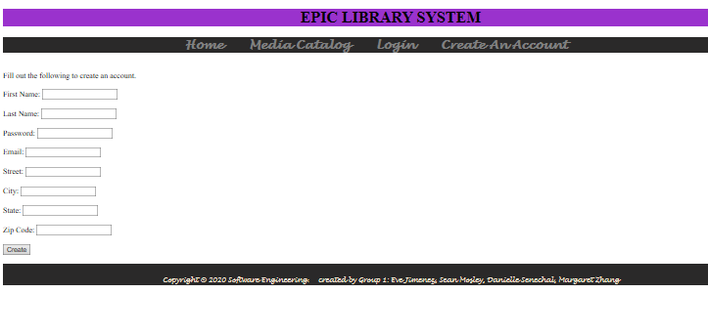
Demonstration: Creating an Account
Users must input personal information for their own account such as their name and address.
This is to make them easier to identify

Slide 6
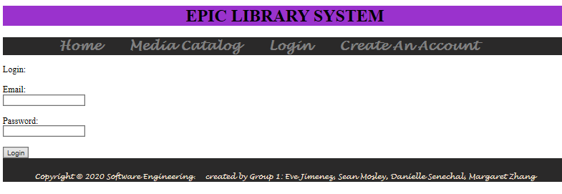
Demonstration: Login
If user already has an account, they may login.
The email and password they used when creating their account is required

Slide 7
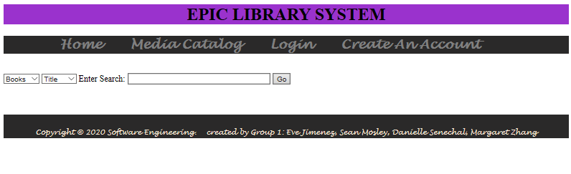
Demonstration: Search bar
Users may search by specifying two dropdown lists:
Media type (i.e. books, cds, movies)
Media details (i.e title, author, etc)
Once enter is hit it will connect with the SQL database to locate item

Slide 8
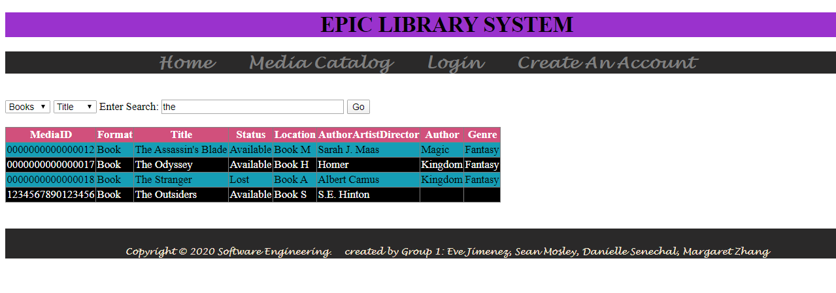
Demonstration: Search
When a search is successful, information about the books retrieved are displayed in a table.

Slide 9
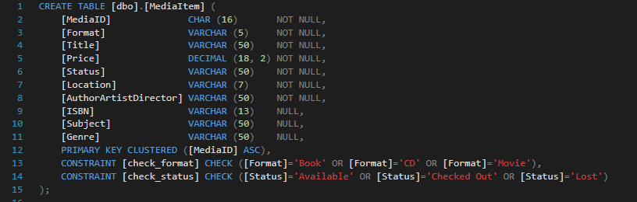
Method: SQL Database Items
Using SQL we created four different tables:
Media Items, checked out items, available card numbers, and account holders
Primary key: Media ID –unique, not null
Checks work as the communication between server and database. Placed a check for media type and status of the media

Slide 10
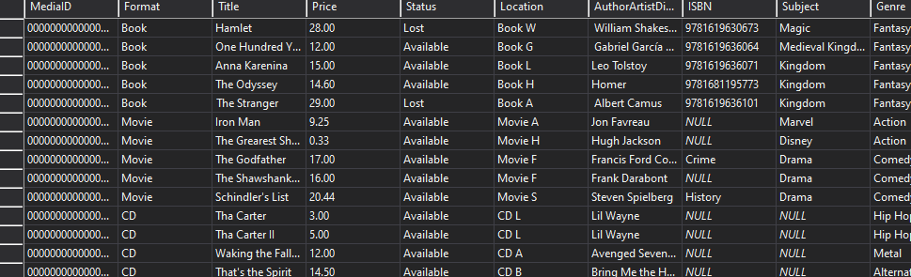
Method: SQL Database Items Details
We then added information about each media type in.
Media ID, Title, Format, Location, Author, Subject, Genre help identify the book through the dropdown search
Status helps users know whether the book is available
ISBN, Subject, and Genre are the only ones that allow null.

Slide 11
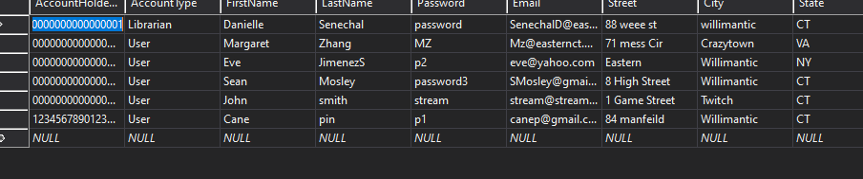
Method: SQL Database Account
Each account had to have
Account Holder # (library card, is the quickest way to identify user)
Account type (identifies what each user has access to)
First and last name, password, email, address (helps identify the user)
Primary key: Account Holder # (

Slide 12
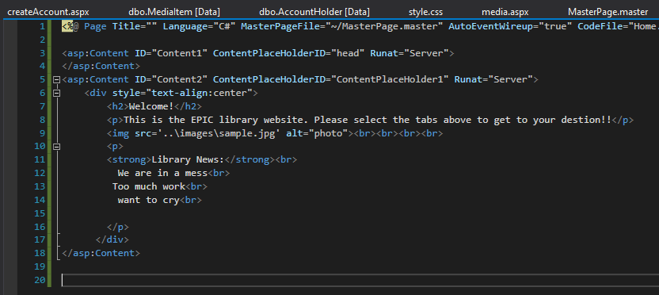
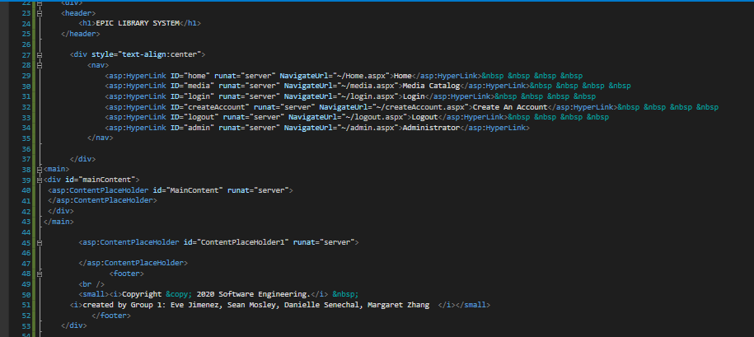
Method: Home Page asp.Net

Slide 13
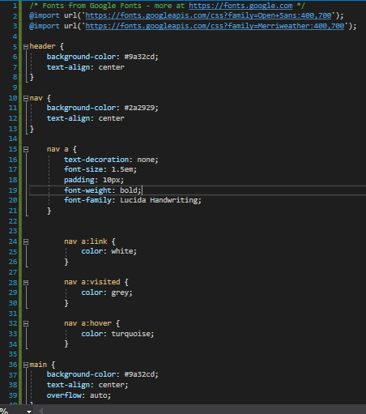
Method: Web Page Design
Using HTML and CSS we made the web page user friendly

Slide 14
Summary
We created a working Library Database Program with a search bar, login page, create an account page, user account information storage, different levels of accessibility (library user, guest, registered user) and records of media available and unavailable
Created 4 tables using SQL for Library Database
asp.Net was used as our software server
HTML and CSS used for website design

